Slide 1
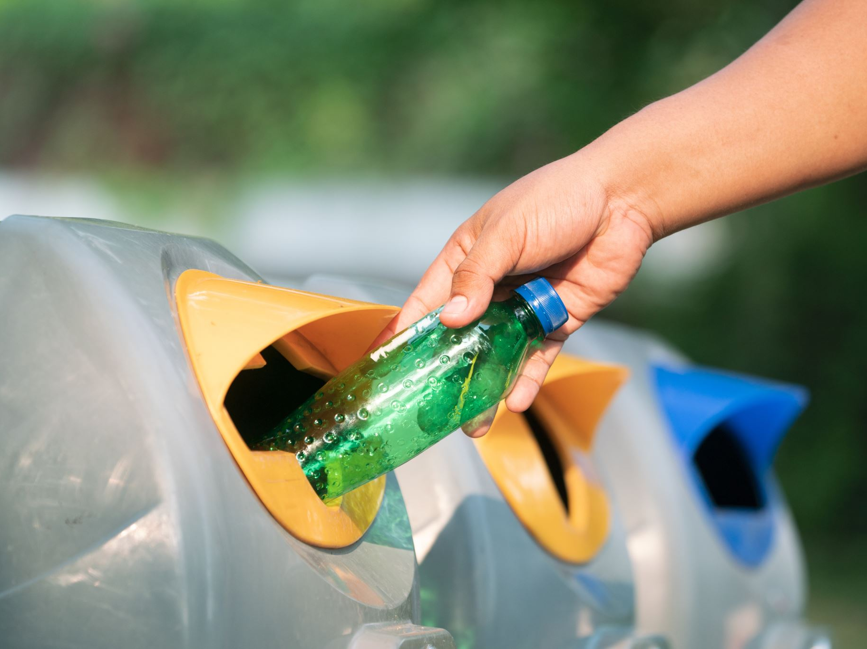
BIN BUSTER
1st^{h} October
PRESENTED BY
Bhavana k Babu ,MES23MCA2010

Slide 2
GUIDED BY Mr. BALACHANDRAN. K.P department of COMPUTER APPLICATION MES COLLEGENGINEERING,KUTTIPPURAM

Slide 3
CONTENTs
Overview
Functionality
Software & Hardware Requirements
Product Backlog
Project Plan
Sprint
User Stories

Slide 4

OVERVIEW
The Bin Buster system is a comprehensive platform designed to streamline waste management.
Users can easily register complaints about bin issues, which are managed by the admin and assigned to drivers for resolution.
The admin oversees bin management, driver profiles, and task assignments. Once tasks are completed, drivers update the status for the admin to monitor, ensuring transparency and accountability.
This integrated system optimizes waste management, promoting a cleaner and more sustainable environment.

Slide 5
Functionalites
An integrated system to optimize the waste management, promoting a cleaner and more sustainable environment.

Slide 6

____ _ _____ ____ _____ ___ _____ __ _______ ___________
_____ ___ ____ ___ ______ _______ ___ __ _______ _________
_____ _____ ___ ____ ___ ______ ___ ______ ___ _______ __ _______ ___ _______ __ _______ _________
_____ ______ ____ ___ _____ ______
_____ _____ ______ ____ ___ ______ ___ ______ ______ _______
___ ____ _____ ____ ___ ___ ____ ______ __ _______ __________ _____ __ _______ __ ______
___ __________ ____ ___ ___ ___ _________ ____ ______ ___ ______ ______ __ ___ _________
___ _______ ____ ___ ____ ___ ____ _______
1.ADMIN
In the Bin Buster application, the admin can log in to manage various tasks. They can create, update, or delete waste bins and driver profiles, view work reports submitted by drivers, and address public complaints by updating their status. Additionally, the admin can view user details for better system oversight.

Slide 7

2.USER In the Bin Buster application, users can register and log in to the system. They can submit complaints and later view the status of their registered complaints through the application.

Slide 8

3.Driver In the Bin Buster application, drivers can log in to access their tasks. They can check daily work updates and provide status updates on their progress to the admin.

Slide 9
SOFTWARE AND HARDWARE REQUIREMENTS
Web browser
Software Requirement: • Operating System: Windows • Technology: python ,Django , css ,html , bootstrap • Database: mysql( xampp )

Slide 10
PRODUCT BACKLOG
ID
PRIORITY
SIZE
(Hour)
SPRINT
STATUS
NA ID
PRIORITY
SIZE
(Hour)
SPRINT
STATUS
ID
PRIORITY
SIZE
(Hour)
SPRINT
STATUS
NA
ID | Name | Priority | Estimate [Hrs]
1 | Admin Login
2 | Create bin, Create driver Update/delete bin , Update/delete driver , View complaint , View work report, View use details, Update complaint status
3 | User register , login, Register complaint , view complaint status
4 | Driver login , check daily work, update work status
5 | Deployment, Testing and Validation

Slide 11
PROJECT PLAN
User Story ID | Task Name | Start Date | End Date | Days | Status
Sprint 1
1 | Admin Login
2 | Coding
3 | Testing
Sprint 2
4 | Create bin, Create driver Update/delete bin , Update/delete driver , View complaint , View work report, View use details, Update complaint status
5 | Coding
6 | Testing
ID
PRIORITY
SIZE
(Hour)
SPRINT
STATUS
NA ID
PRIORITY
SIZE
(Hour)
SPRINT
STATUS
ID
PRIORITY
SIZE
(Hour)
SPRINT
STATUS
NA

Slide 12
IDPRIORITY
SIZE
(Hour)
SPRINT
STATUS
ID
PRIORITY
SIZE
(Hour)
SPRINT
STATUS
NA
Sprint 3
7 | Database connectivity
8 | User register , login, Register complaint , View complaint status
Sprint 4
9 | Driver login , Check daily work, Update work status
Sprint 5
10 | Deployment
11 | Testing and Validation

Slide 13
USER STORIES
ID | USER | ACTION | PURPOSE
1 | Admin , User , Driver | Login | Access the account
2 | Admin | Create bin , Create driver, Update Bin , Update driver | Manage bin and driver details
3 | Admin | Delete bin ,Delete driver | Remove bin or driver details
4 | Admin | View work report , View complaint , view user details | Access and monitor relevant data
5 | User | User registration, Register complaint | Submit my details and complaints

Slide 14
-
6 | User | My complaint | Check the status and progress of my complaint
7 | Admin , Driver | Update status | Provide updates on tasks or issue
8 | Driver | Check daily work | View my assigned tasks and work for the day

Slide 15


USER JOB HISTROY
As a user (individual/organization),I want to create and manage my profile.
As a user, I want to submit complaints related to bin issues (such as uncollected waste or damaged bins) via a user-friendly interface.
As an administrator, I want to view and manage user complaints AND I want to update the status of complaints as they are resolved.
As an administrator, I want to create, update, and delete bin information (such as location, type, and status).
As an administrator, I want to manage driver profiles (create, update, or delete) AND I want to assign complaints and tasks to specific drivers.
As a driver, I want to update the status of assigned tasks (such as completed waste collection or bin repair) ,I want to monitor driver activities and task statuses.
As an administrator, I want to generate reports and review task histories for drivers and complaints.
As an administrator, I want to optimize the waste management process through better task allocation and resource management

Slide 16
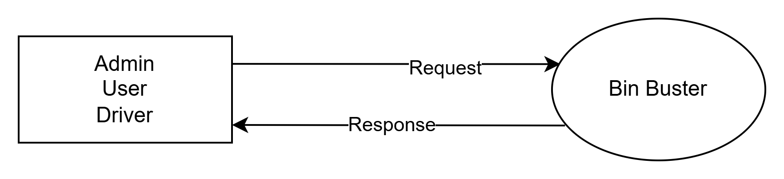
Data Flow Diagram
Level 0

Slide 17
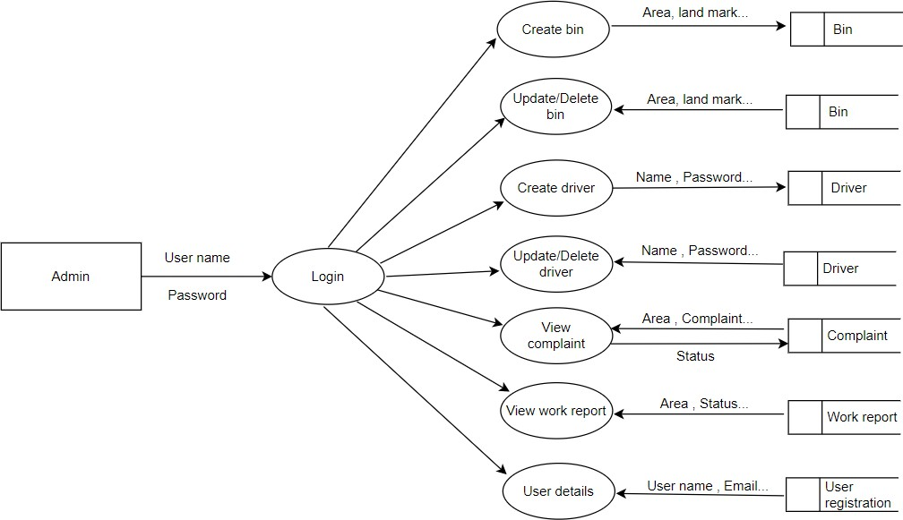
Level 1

Slide 18
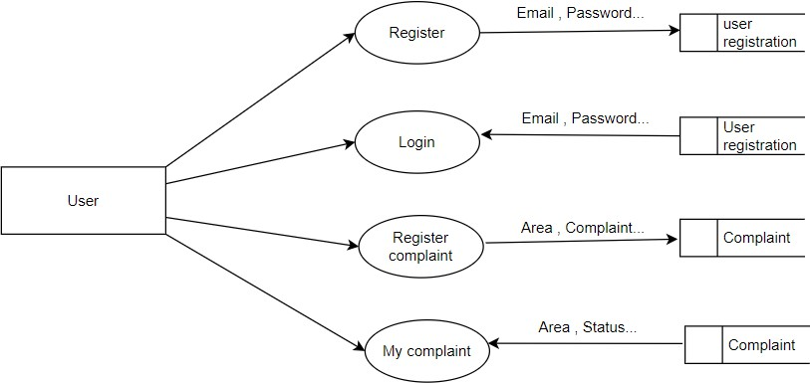
Level 2

Slide 19
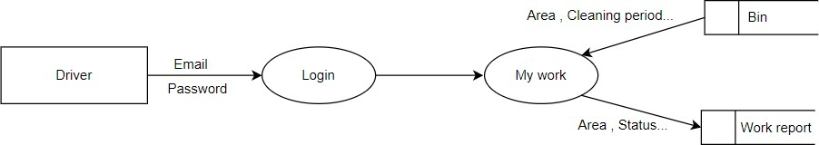
Level 3

Slide 20
THANK YOU

